Slide 1
School Challenge
august 2018

Slide 2
agenda
Problem
Class diagram
Database diagram
SOLID
Unit Tests
QA

Slide 3
agenda
Problem
Class diagram
Database diagram
SOLID
Unit Tests
QA

Slide 4
Problem
A Course has no more than 30 Students, where one of the Students is the “headman” of the Course. The whole course learns the same subjects except for “foreign language” subject (some of the students learn English, French, Spanish and Portuguese). A Teacher can teach one or many subjects, but he just has one Course assigned. The Student can be evaluated by subject, so he will get a partial grade every 4 months, and a final grade at the end of the school year. The final grade is calculated using the three previous grades distributed as follows:
1st grade: 30%
2nd grade: 30%
3rd grade: 40%

Slide 5
agenda
Problem
Class diagram
Database diagram
SOLID
Unit Tests
QA

Slide 6
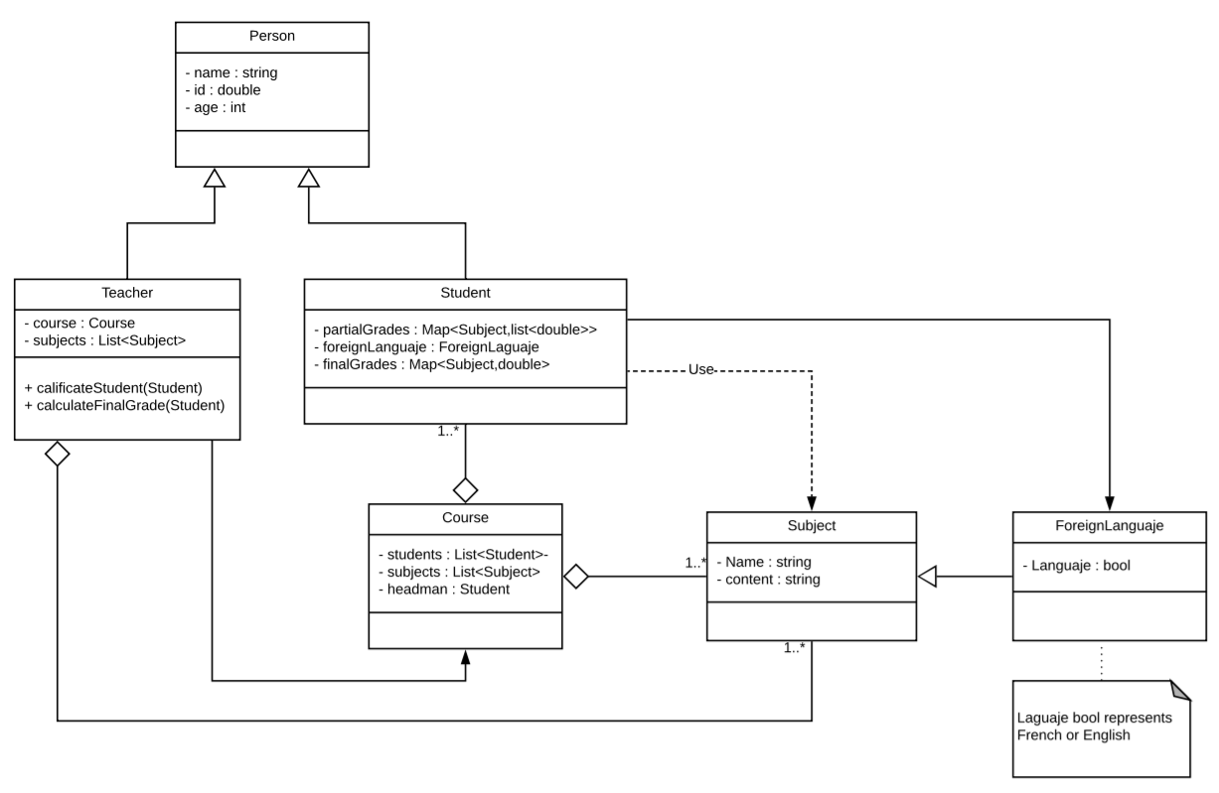
Class diagram first version

Slide 7
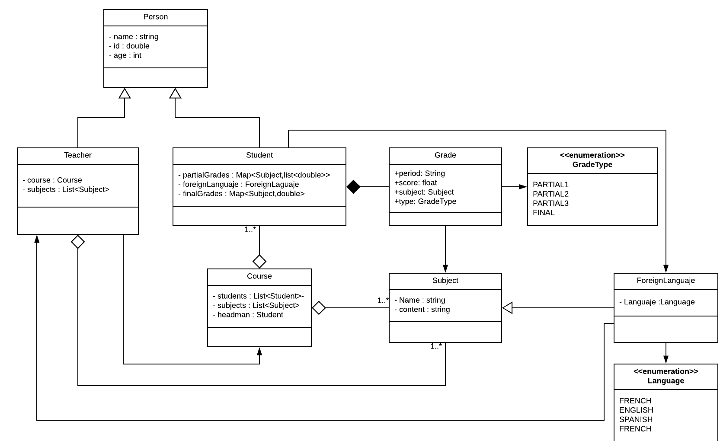
Class diagram Final

Slide 8
agenda
Problem
Class diagram
Database diagram
SOLID
Unit Tests
QA

Slide 9
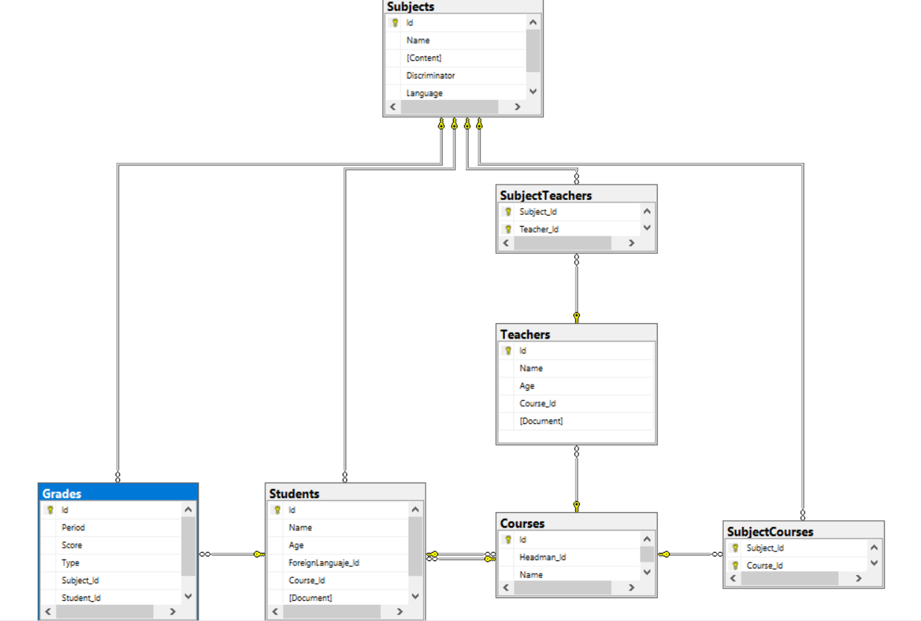
Database diagram

Slide 10
agenda
Problem
Class diagram
Database diagram
SOLID
Unit Tests
QA

Slide 11
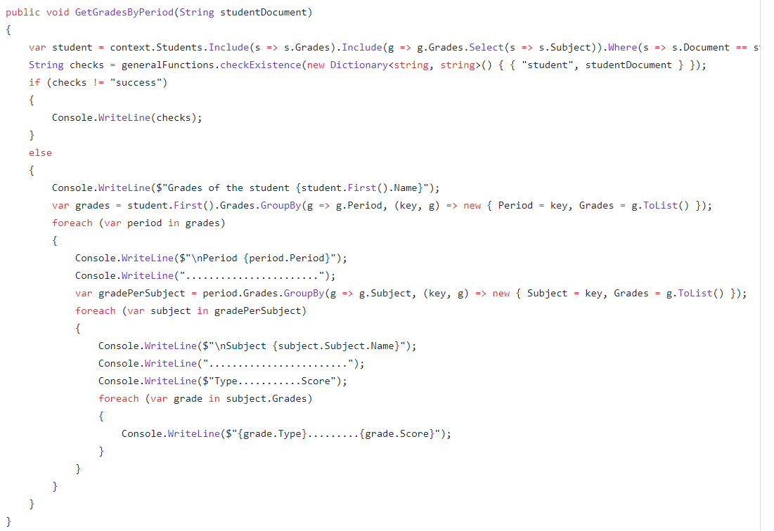
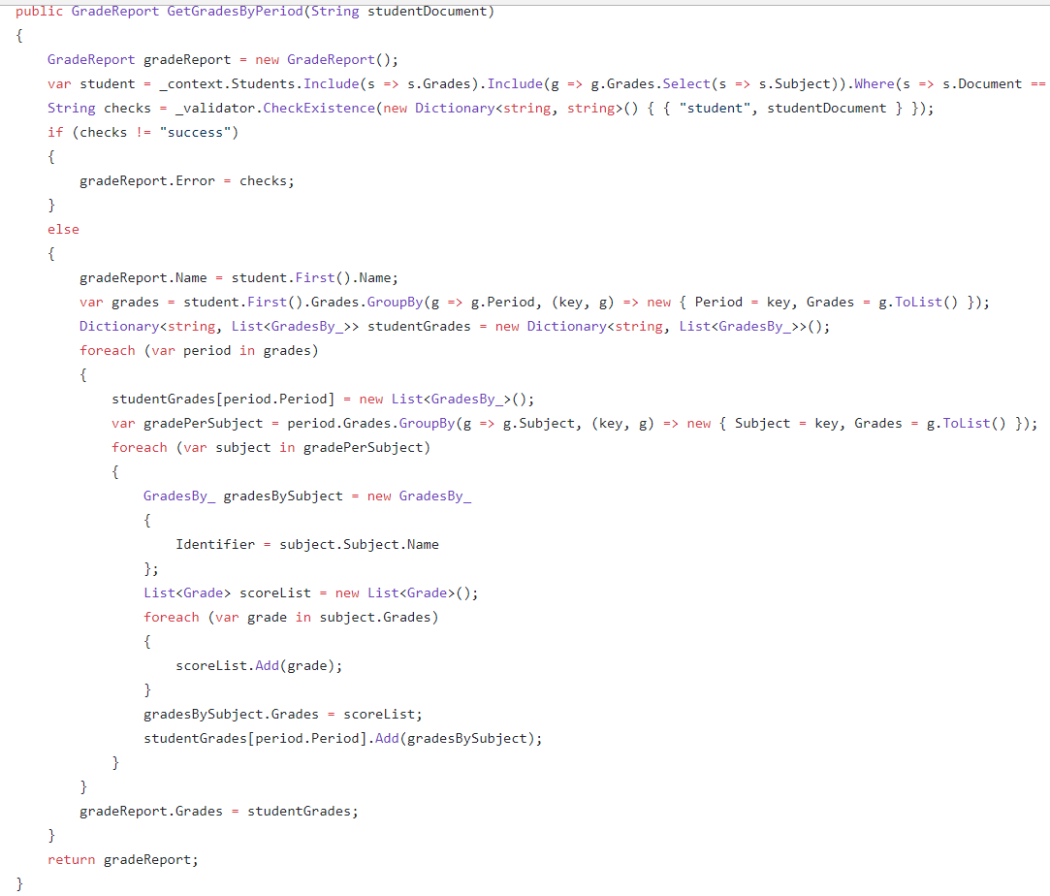
SOLID
Single responsibility principle

Slide 12
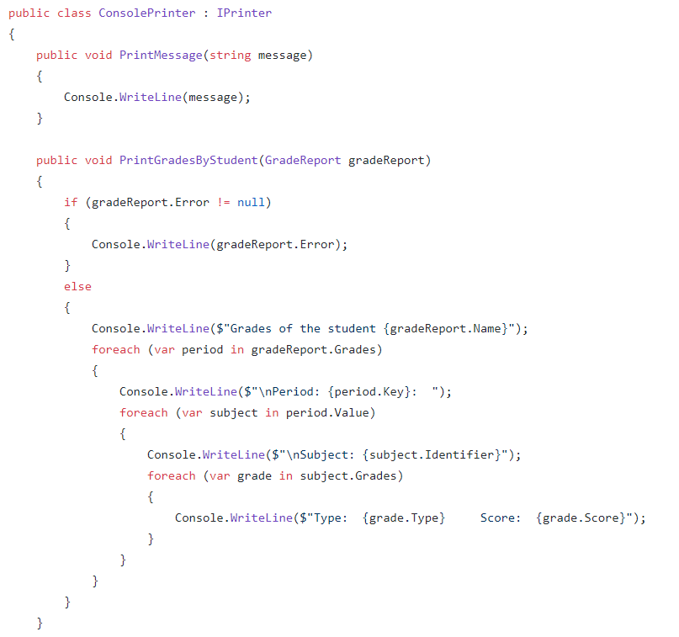
SOLID
Single responsibility principle

Slide 13
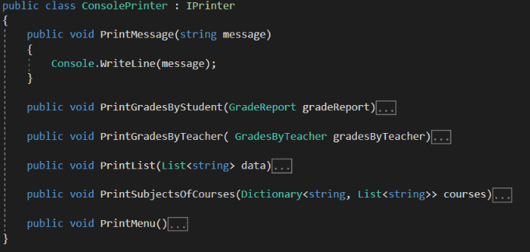
SOLID
Open closed principle

Slide 14
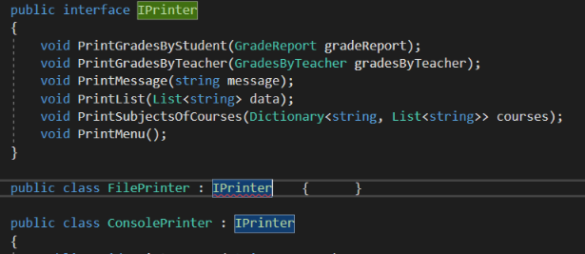
SOLID
Liskov sustitution principle

Slide 15
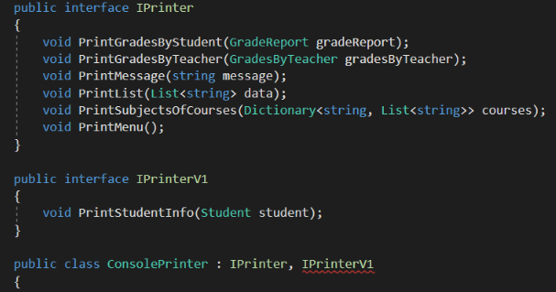
SOLID
Interface segregation principle

Slide 16
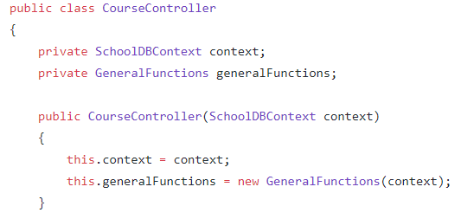
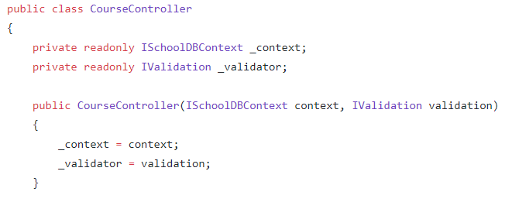
SOLID
Dependecy inversion principle

Slide 17
agenda
Problem
Class diagram
Database diagram
SOLID
Unit Tests
QA

Slide 18
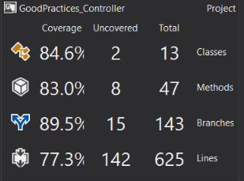
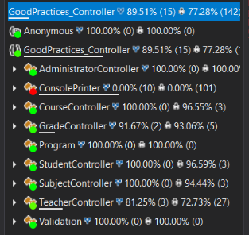
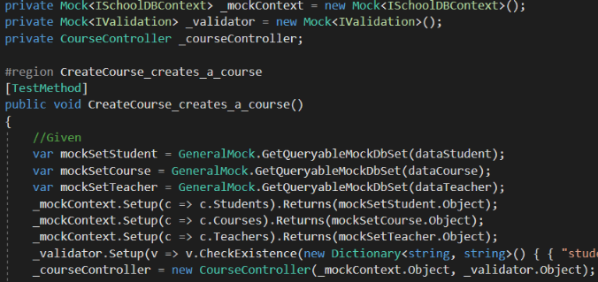
Unit tests

Slide 19
agenda
Problem
Class diagram
Database diagram
SOLID
Unit Tests
QA

Slide 20

Questions

Slide 21
THANK YOU
Luis valderrama
Backend intern
Luis.Valderrama@endava.com

